Slide 1
Reverse Engineering PCBs with JTAG
Unallocated Space Minicon (July 2015)
David Protzman

Slide 2
Agenda
Why reverse engineer boards?
Reverse engineering the hard way
What is JTAG?
Required equipment and software
Pinning out an FPGA RF board
Will contain live demo

Slide 3
Why Reverse Engineer?
I love FPGA boards
They are unholy expensive to buy new ($1,000’s in a lot of cases)
People sell them on eBay for stinky cheap (< $100)
Trouble is, most of these boards are specialized and have no documentation
These are the most interesting ones!
Without the documentation, there is no easy way to know what connects to what (and exactly what pins connect to where)

Slide 4
Sometimes I run across boards that have really cool RF circuitry
I’m a sucker for high speed analog to digital conversion :D
Pretty much every board I have run across that has RF circuitry ends up being proprietary and without any form of documentation
In this scenario, I have to attempt to figure out how the board works
This is where reverse engineering comes in

Slide 5
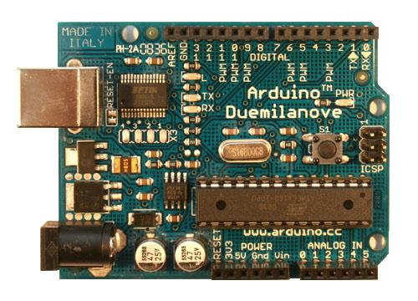
The Difficult Method
Let’s start off with a very simple example
Suppose that for some reason you don’t have any documentation about the layout of an Arduino Uno board
You want to figure out what connects to the pin headers along the edges
We’ll start with the digital pins

Slide 6
The Difficult Method
The easiest first thing to do is simply look at the board
Can you see the traces?
If so, do any of the traces go directly to the ATMega?
Then success! No need to poke that one!
If not, then do you see any vias on the trace?
If so, then flip the board over and see if you can follow the trace to the ATMega
Otherwise, you likely have a board with more than 2 layers
This means you cannot determine the connection visually :(

Slide 7
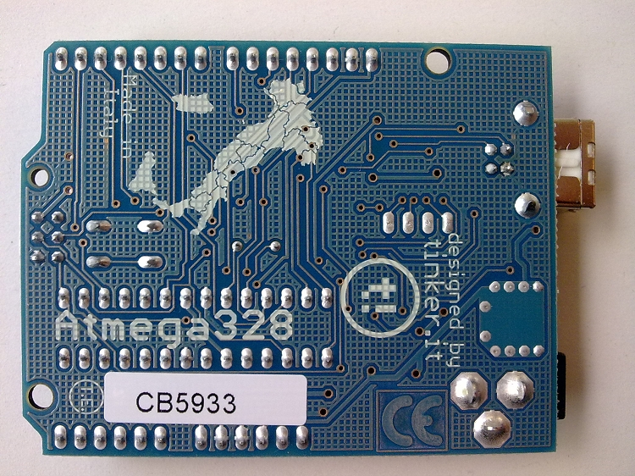
The Difficult Method
Let’s look at digital pin 4
The picture below is of the top of an Arduino Duemilanove
You should notice that there is no trace coming from digital pin 4

Slide 8
The Difficult Method
Now flip the board over and find digital pin 4 again
The numbers start at 0 and the pins are on the same side as the USB port
You should notice that pin 4 does have a trace on the bottom!
And, it goes all the way from the pin to the ATMega :D

Slide 9
The Difficult Method

Slide 10
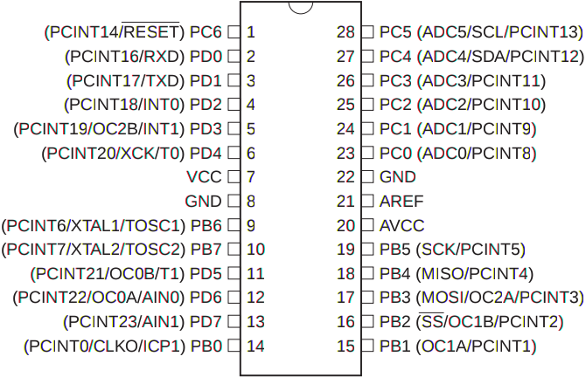
The Difficult Method
Taking a look at the ATMega 328P datasheet you’ll find out that the 6th pin from the top (look at the notch) on the left is PD4

Slide 11
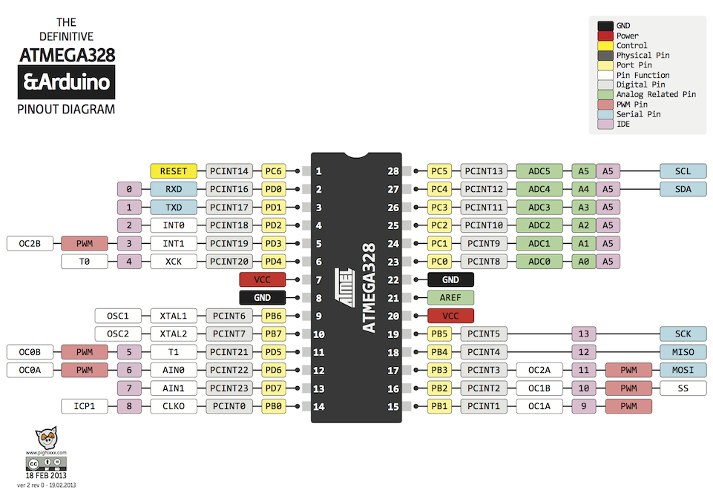
The Difficult Method
Looking up what pins on the ATMega 328P map to which Arduino pins
(Just Googled “arduino pinout”)
Pin 6 is digital pin #4!

Slide 12
The Difficult Method
That’s one method of figuring out what connects to what
Another easy method is to use a multimeter

Slide 13
The Difficult Method
Caution:
Your multimeter outputs a certain voltage in order to determine resistance or continuity
This voltage might be higher than the components you are poking can handle
Even so, I’ve never had an issue with it, so you should be safe :)

Slide 14
The Difficult Method
We’ll use the Arduino one more time for this exercise since it’s easy to use
Look at digital pins 2 and 3
No trace is visible on top

Slide 15
The Difficult Method
Flip the board over and see if there is a trace there
There is, but it stops
It’s connected to a ‘via’

Slide 16
The Difficult Method
Vias are holes in the PCB that connect different layers together
This trace goes from the bottom of the board to the top
It’s sometimes difficult to tell exactly which via is the right one when you flip the board over
A multimeter comes in really handy at this point

Slide 17
The Difficult Method
Set your multimeter to ohms (or continuity/beep mode if you have it)
Connect one probe to digital pin #2
You might have to touch the probe to the point on the bottom of the board where the header attaches
Connect the other end to one of the two vias on top of the board just above the switch

Slide 18
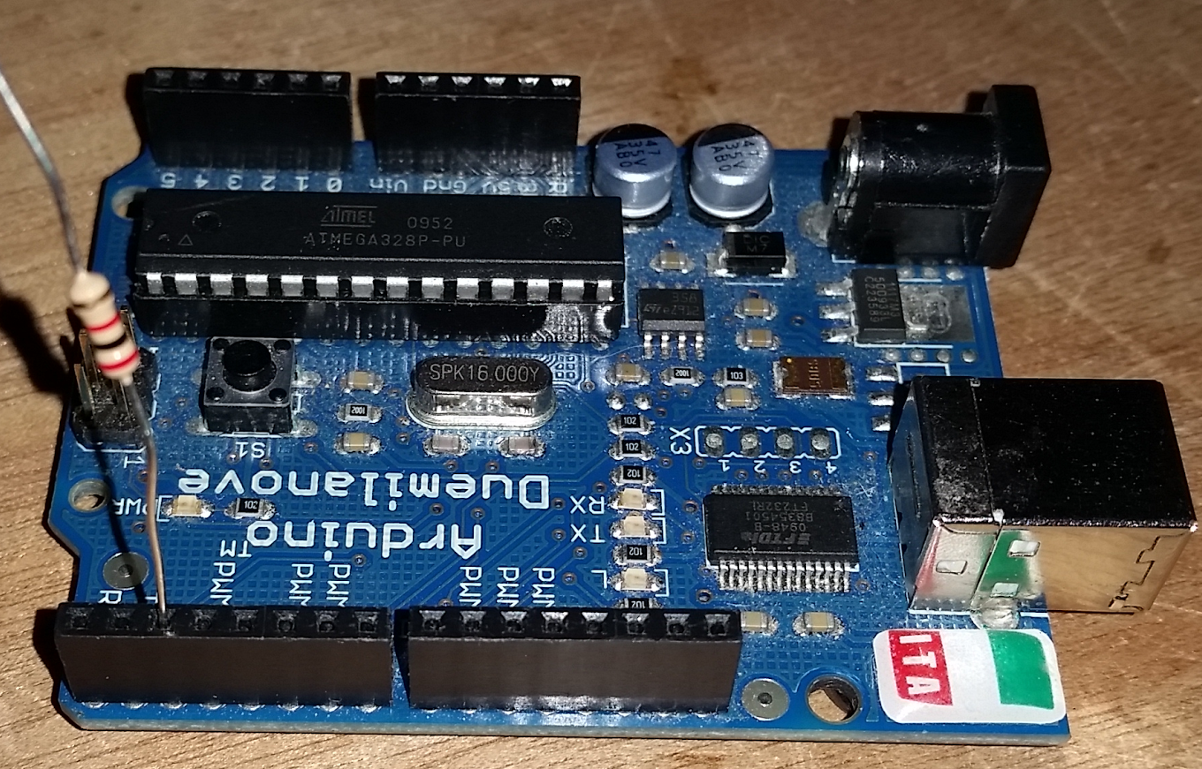
The Difficult Method
Here is an example of using something to give the probe access to the pin in question
A resistor is plugged into the female header and now the probe can be connected to the bottom side of the resistor
Don’t use the top as that adds resistance!

Slide 19
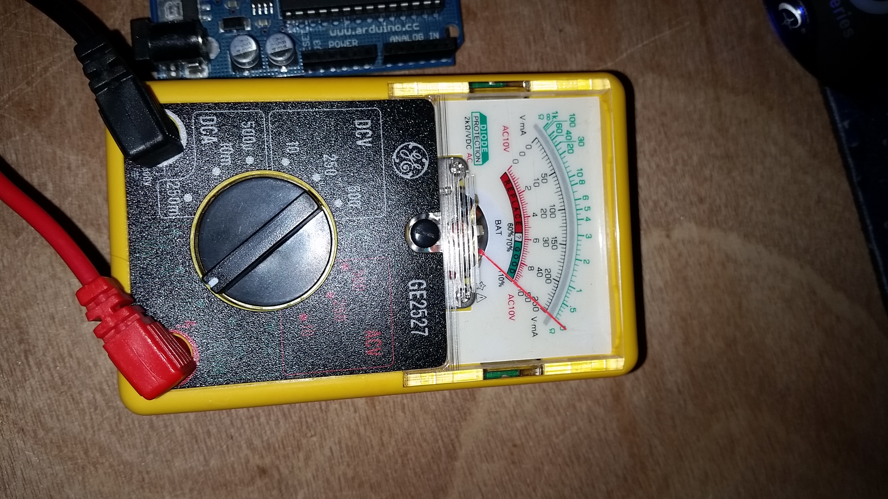
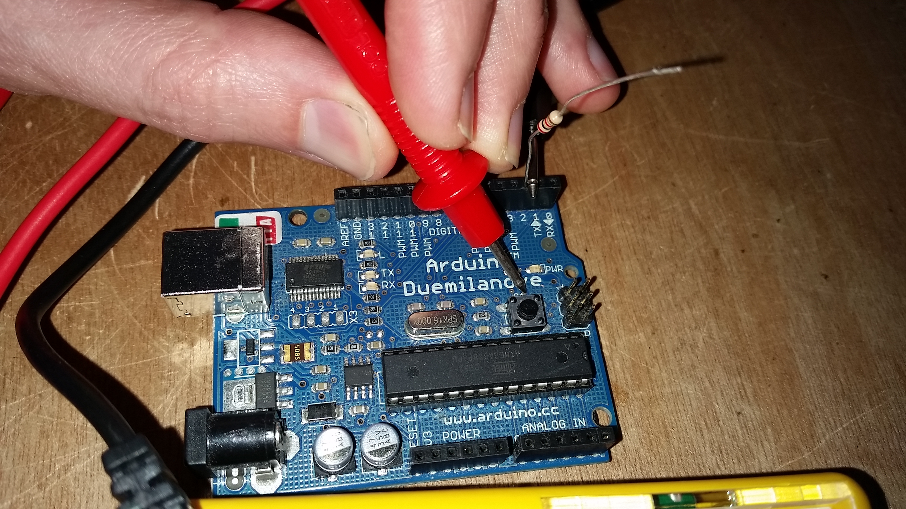
The Difficult Method
Here is an example of testing for a connection between pin #2 and the rightmost via
Done using one hand which is why it looks awkward…
Also shown is what my (analog) multimeter shows
Which is no resistance!

Slide 20
The Difficult Method
In this situation you are looking for no resistance
Sometimes a little resistance is expected
In those cases you want to hunt down whatever is causing the resistance
Most likely a resistor, capacitor, or some other passive component
For fun, try checking the continuity of the other via
You should get infinite resistance since there is no connection

Slide 21
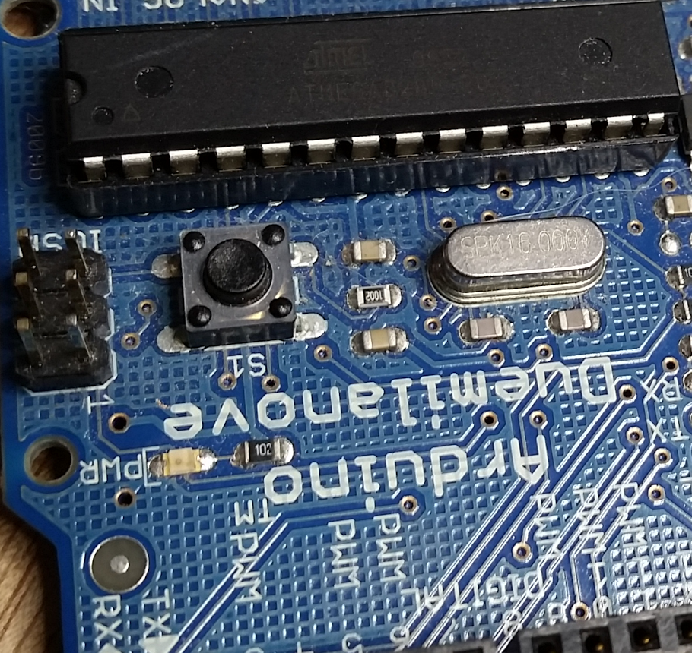
The Difficult Method
The last step here is to figure out where the top of the via connects
In this case it’s a little obscured by the switch
But, if you look closely you’ll see that the trace goes almost straight through the bottom of the switch and lands at pin 4 of the ATMega 328P
The image isn’t all that clear :(
Testing that connection with a multimeter should show zero resistance

Slide 22
The Difficult Method
Okay, so that’s it for manually finding connections
This presentation is really about using JTAG to accomplish this
So, let’s get to the JTAG-y goodness!

Slide 23
What is JTAG
JTAG stands for Joint Test Action Group
IEEE 1149.1
The idea of JTAG is to be able to test a chip after manufacturing to determine if there are flaws
It uses a simple 4 (or more) pin serial interface
Sort of like SPI

Slide 24
What is JTAG
The most common JTAG interfaces have the following 4 pins:
TMS (Test Mode Select): Determines the next step through the state machine (more on this later)
TCK (Test Clock): Clocks the serial lines
TDO (Test Data Out): Data leaving the JTAG device
TDI (Test Data In): Data entering the JTAG device

Slide 25
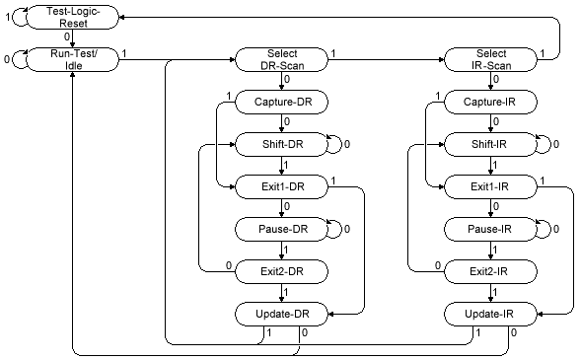
What is JTAG
As mentioned in the last slide, there is a JTAG state machine
Consists of two chains:
DR (Data Register)
IR (Instruction Register)
TMS controls movement between each state
All actions take place on the rising edge of the TCK input
This entire chain is just one big shift register!
Something is always clocked out of the TDO line, but it might not be of any use depending on the instr.

Slide 26
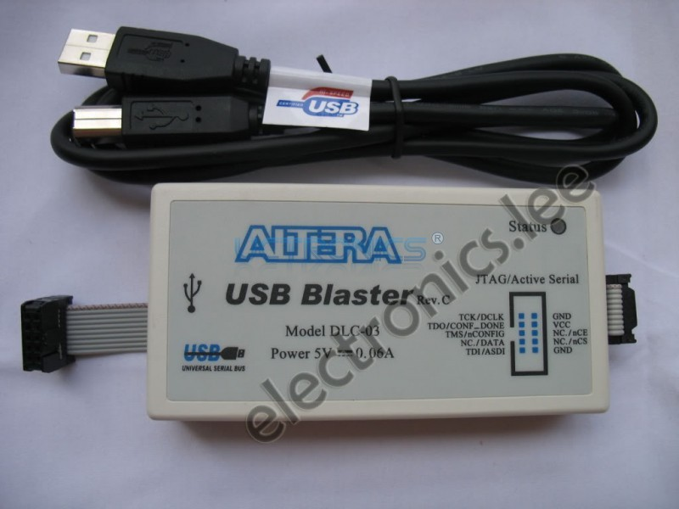
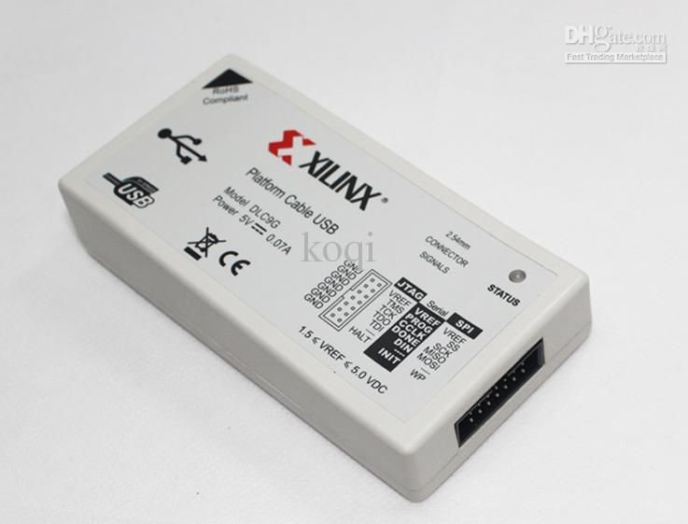
Hardware Requirements
You could create your own JTAG device using something like an Arduino, ARM, FPGA, CPLD, etc
But, there are ready made solutions that don’t cost all that much
Though you will have to get them from China…
My personal favorites are:
Altera USB Blaster
Xilinx DLC9G

Slide 27
Hardware Requirements
Aside from the ease of use, it’s nice to have a ready made JTAG device because you will find more software packages that support them
Oh, and the better JTAG programmers are much faster than what you’ll make with an Arduino!
The DLC9G can run up to 25 MHz which is pretty fast
Oddly, the Altera USB Blaster seems to be the most widely supported JTAG programmer for free tools
Surely thought that Xilinx would win there...

Slide 28
Hardware Requirements
A note about “JTAG Programmer”
JTAG started as a way to test chips
It was later used to actually program things like flash, CPLDs, FPGAs, CPUs, etc
So, you will mostly see “JTAG programmer” even though they are more than simple programmers

Slide 29
What is JTAG
There are 3 required JTAG instructions (all fall under “boundary scan”)
EXTEST
Meant for testing connections between devices
PRELOAD/SAMPLE
The JTAG device runs like normal, but you can load data into the chain that can later be applied to the IO pins with EXTEST (PRELOAD) or you can grab the current value of IO pins (SAMPLE)
BYPASS
Skip this device (more on this later)
Different vendors support more advanced commands
IDCODE is an example of one that is commonly seen

Slide 30
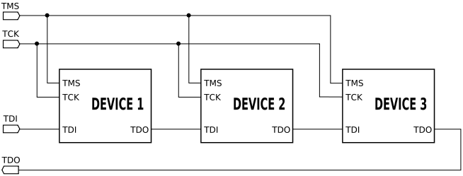
What is JTAG
The BYPASS instruction is special
It basically says “skip this device”
What ends up happening is that everything you clock into the JTAG chain will be clocked out on the next rising edge of TCK
You might be wondering why this would be important
Well, devices that support JTAG can be chained together!
This is where JTAG becomes very SPI-like

Slide 31
What is JTAG
You can chain infinitely many devices (physics allowing)
When you have multiple JTAG supported devices chained together then you need some way of only letting one listen at a time
This is what BYPASS does
If a JTAG supporting device is in BYPASS mode, then it just echos what it reads in
So, if there were 3 devices in the chain, then two would need to be in BYPASS

Slide 32
What is JTAG
It should be noted that all of the devices can be in BYPASS mode
You might wonder what good that would do
Turns out, it’s incredibly useful in finding out how many devices are in the JTAG chain
You know:
BYPASS delays the input by one cycle
When in BYPASS, the input (TDI) is simply echoed to the output (TDO)
So, if you clock in a pattern of bits (10101010111 for example) then you can measure the amount of clocks it takes to get that pattern back
That tells you how many devices are in the chain!

Slide 33
What is JTAG
Okay, so that’s enough of JTAG specific stuffs
Let’s focus in on the SAMPLE instruction
This allows us to snoop in on what is happening to the device’s IO pins

Slide 34
Required Software
Before we can actually look at what’s going on we need some software to talk to the JTAG programmer
The best “free” software I have found is TopJTAG Probe
http://www.topjtag.com/probe/
It’s “free” because it’s a 20 day trial
But I have not found any tool that comes close to it that’s completely free
Oh, and it’s Windows only :(
TopJTAG Probe provides a graphical representation of what’s going on in the chip
You can even plot the values of the IO pins using a logic analyzer type view

Slide 35
Required Software
Okay, so we have the knowledge, hardware, and software
Now how does the JTAG programmer connect to the circuit board??

Slide 36
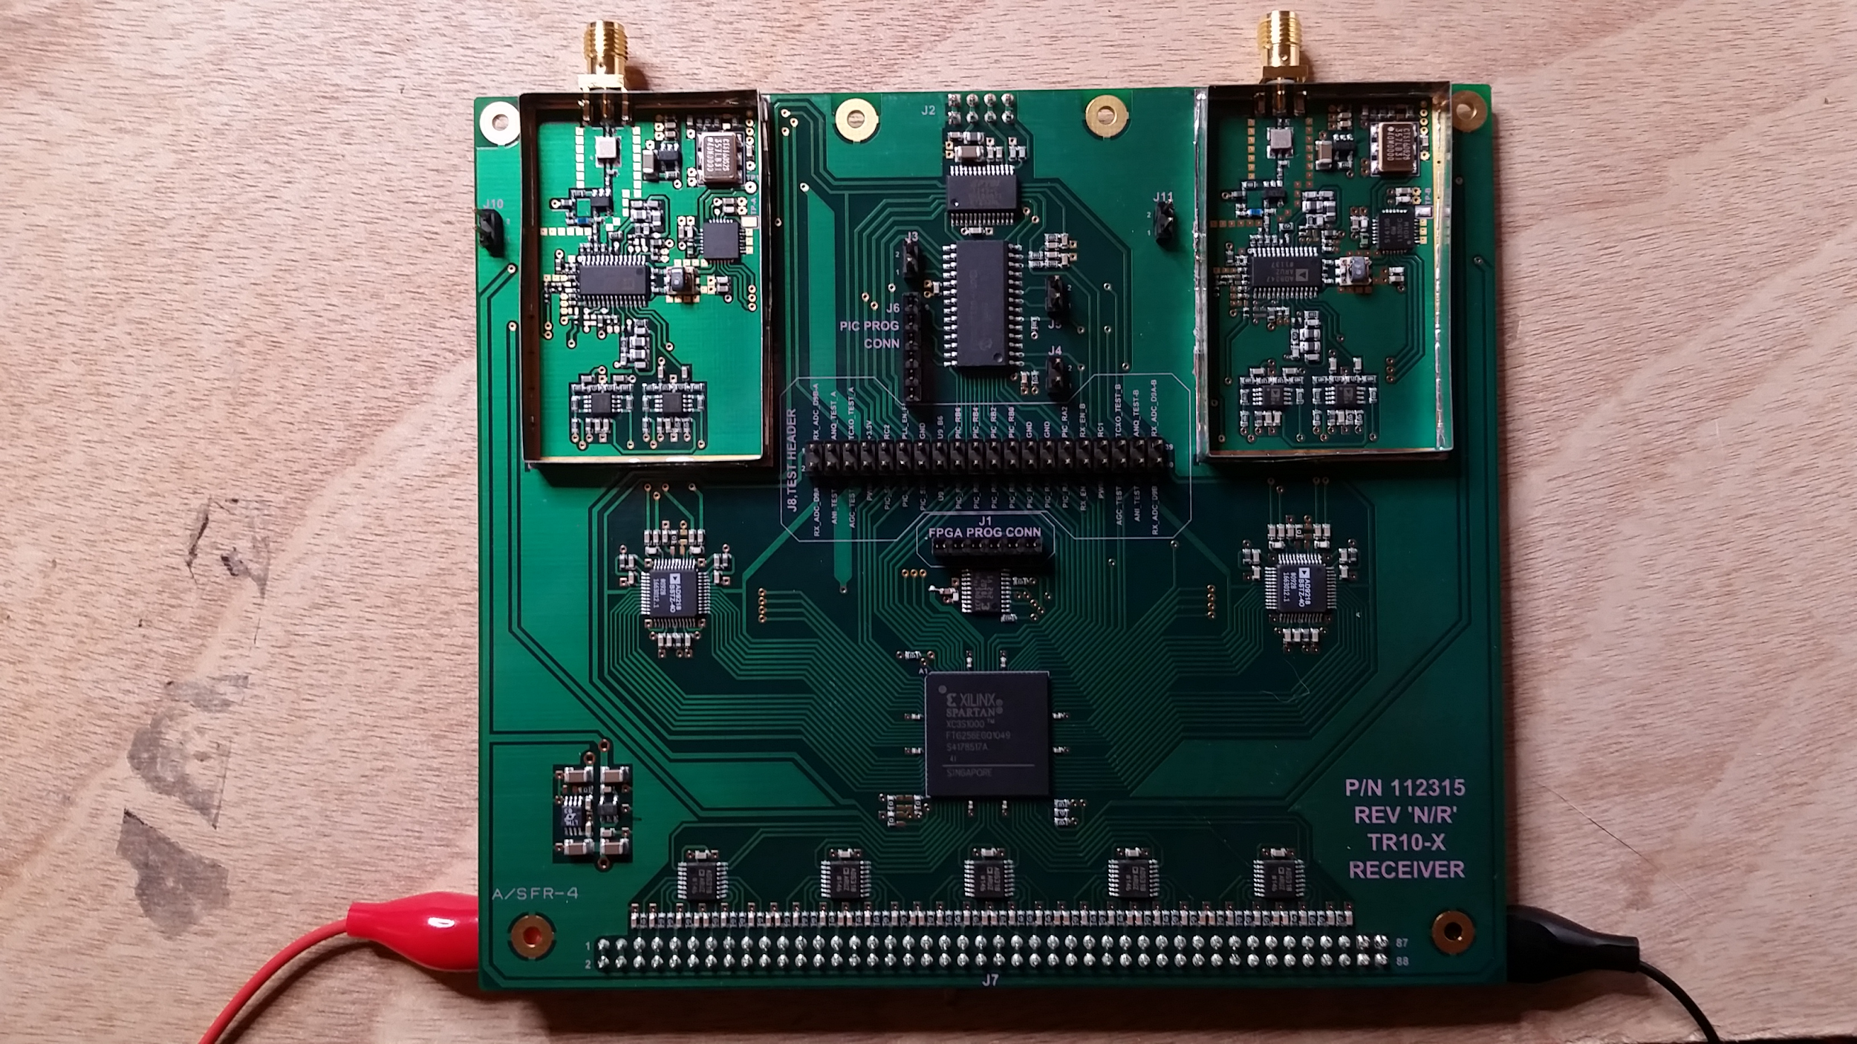
Pinning out an FPGA Board
Here is the board that this presentation is all about
It has two analog front ends for capturing ~ 900 MHz - 980 MHz
Each front end goes to its own 40 MSPS analog to digital converter
Both converters feed into the Xilinx Spartan 3S FPGA
From there the FPGA can output 5 channels of data through 5 low speed (~ 1 MSPS) digital to analog converters

Slide 37
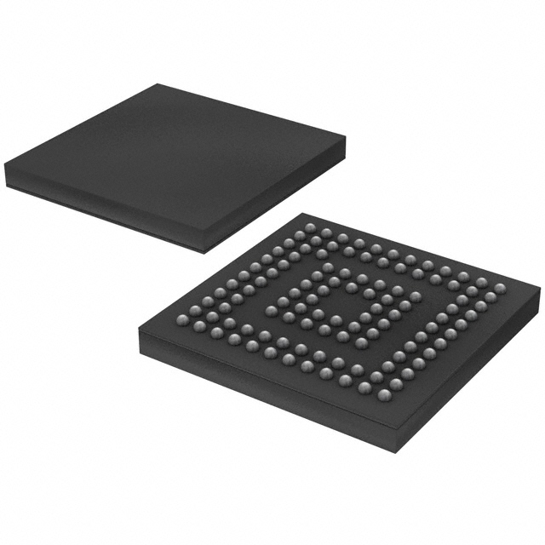
Pinning out an FPGA Board
One of the things to notice is that the FPGA chip (bottom center) does not have any pins exposed
That’s because the FPGA being used is in a ball grid array (BGA) package
Instead of pins on the edges of the chip there are a bunch (256 in this case) small solder balls on the bottom of the chip and an equal number of pads on the circuit board
BGA parts make troubleshooting and reverse engineering difficult
But this is where JTAG shines!

Slide 38
Pinning out an FPGA Board
The Xilinx FPGA supports JTAG!
This means that we can poke at it using JTAG without having to sit and trace wires all over the place
But where does the JTAG programmer hook up at?

Slide 39
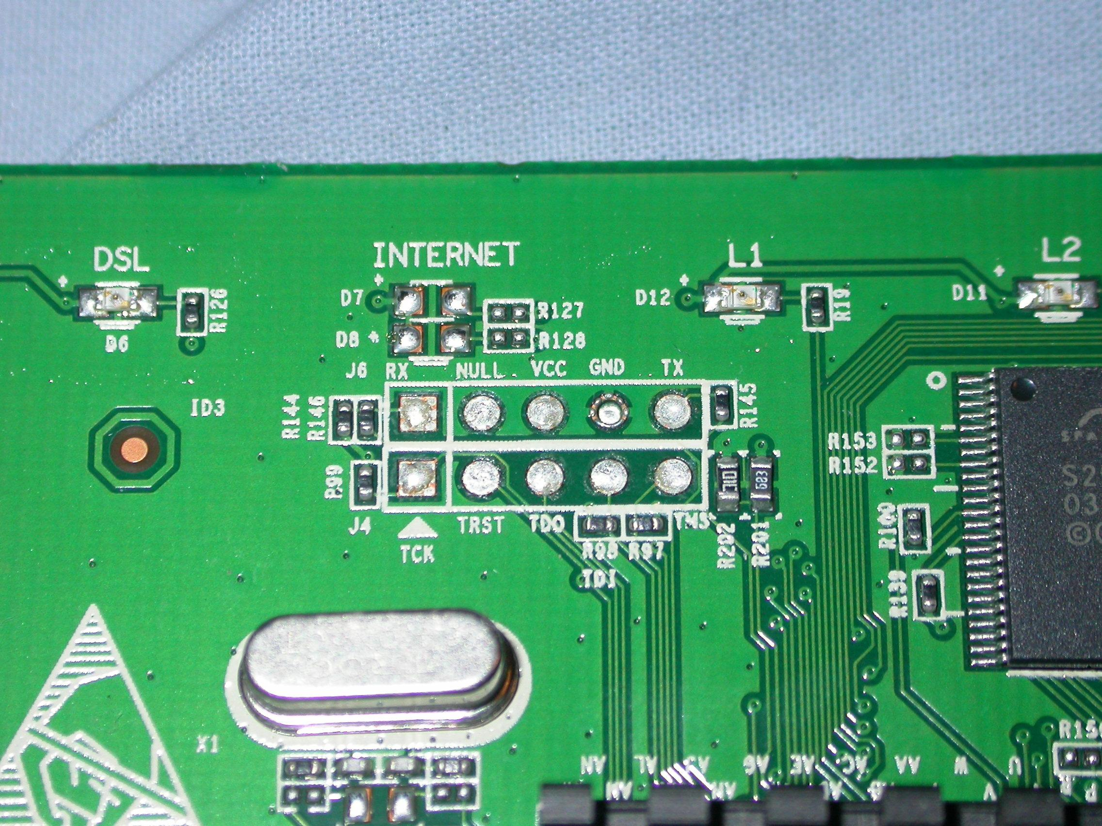
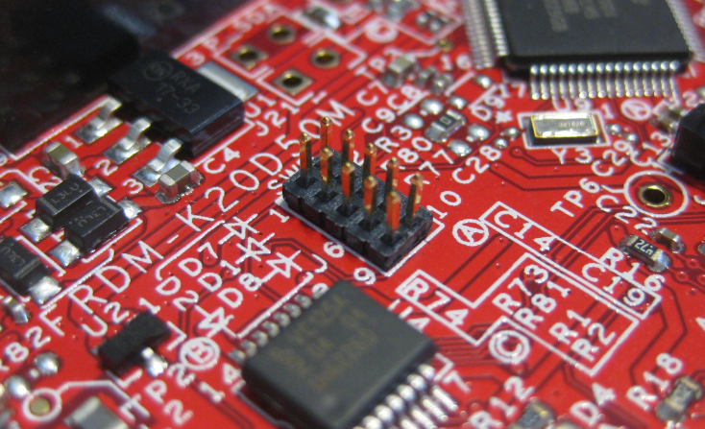
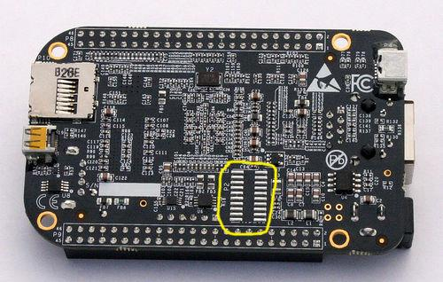
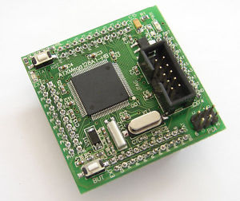
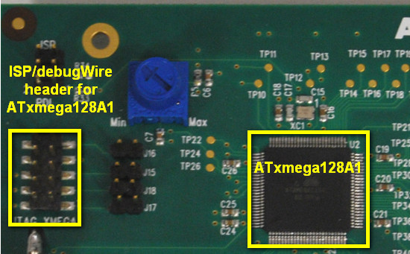
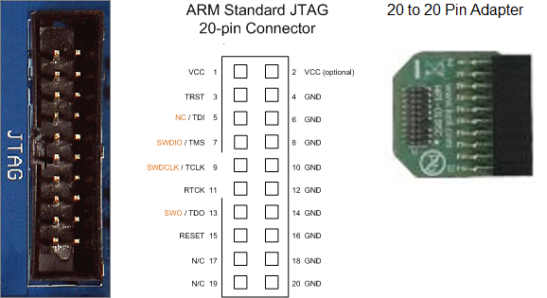
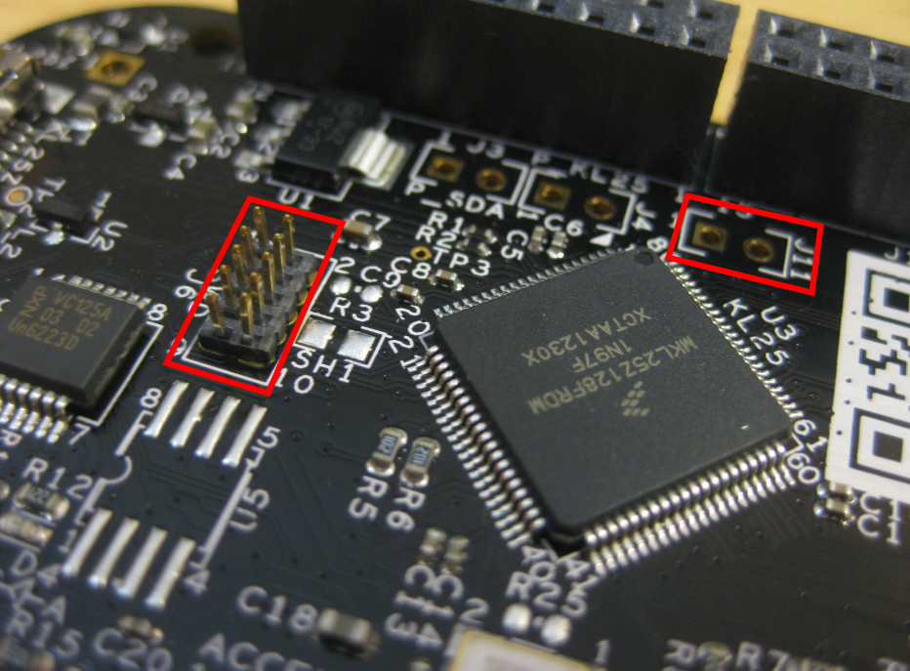
Pinning out an FPGA Board
This part is usually pretty easy
JTAG has a hand full of common header styles

Slide 40
Pinning out an FPGA Board
Sometimes you get really lucky and things are quite literally spelled out
Here you can see that there is a 6 pin connector with the words “FPGA PROG CONN”
Chances are, this is the JTAG header

Slide 41
Pinning out an FPGA Board
In this case there are 6 pins total
When you have 6 pins there is a really good chance that you have 4 JTAG pins, ground, and supply voltage
The JTAG programmer is not actually powering, or being powered by the supply from the circuit board
The voltage is there as a reference so that the JTAG programmer knows what voltage to use for TCK, TDO, TDI, and TMS
Ground is there because all things electrically connected should have a common ground

Slide 42
Pinning out an FPGA Board
The easiest way to determine which pins are power and which are ground is to look at the board
A lot of times there will be a ground plane on the top and/or bottom of a circuit board
The top left of the board is a good example of finding a ground connection
Notice that the copper circles are attached to the large areas of copper
You can use these landmarks to figure out where grounds are (sometimes…)

Slide 43
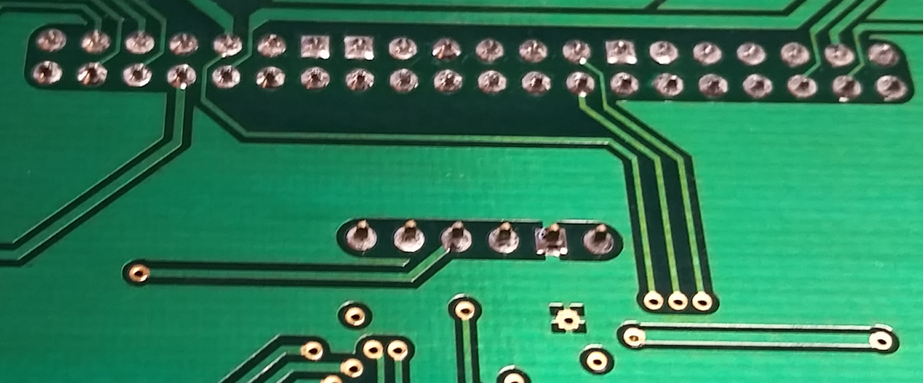
Pinning out an FPGA Board
Here is a shot of the bottom of the JTAG header
Notice that the second to the right pin connects to the ground plane
Now we know where the ground is!
The supply will be a little more difficult

Slide 44
Pinning out an FPGA Board
Figuring out which pin is supply can be tricky
You first need to find where the supply voltage is supplied to
This board does not actually show where supply is
But, it’s not difficult to figure out!

Slide 45
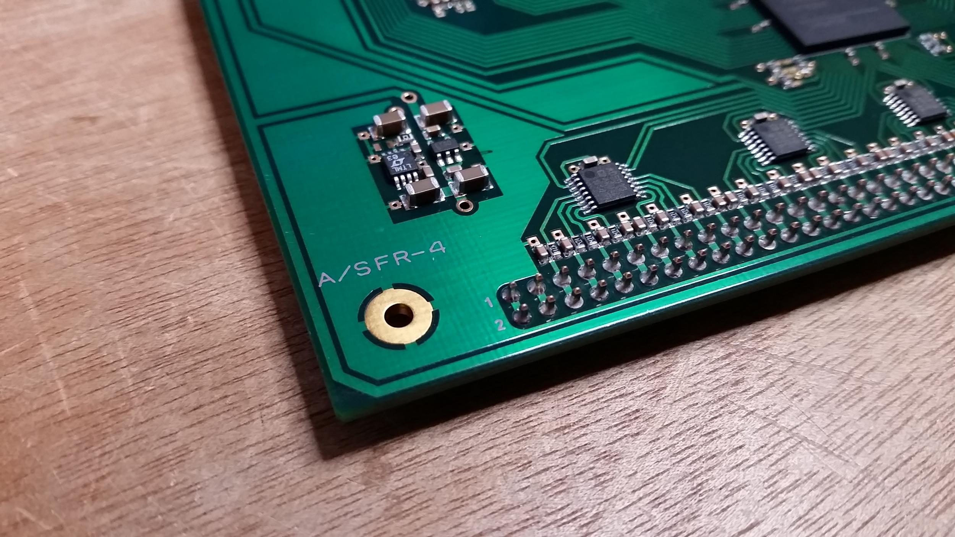
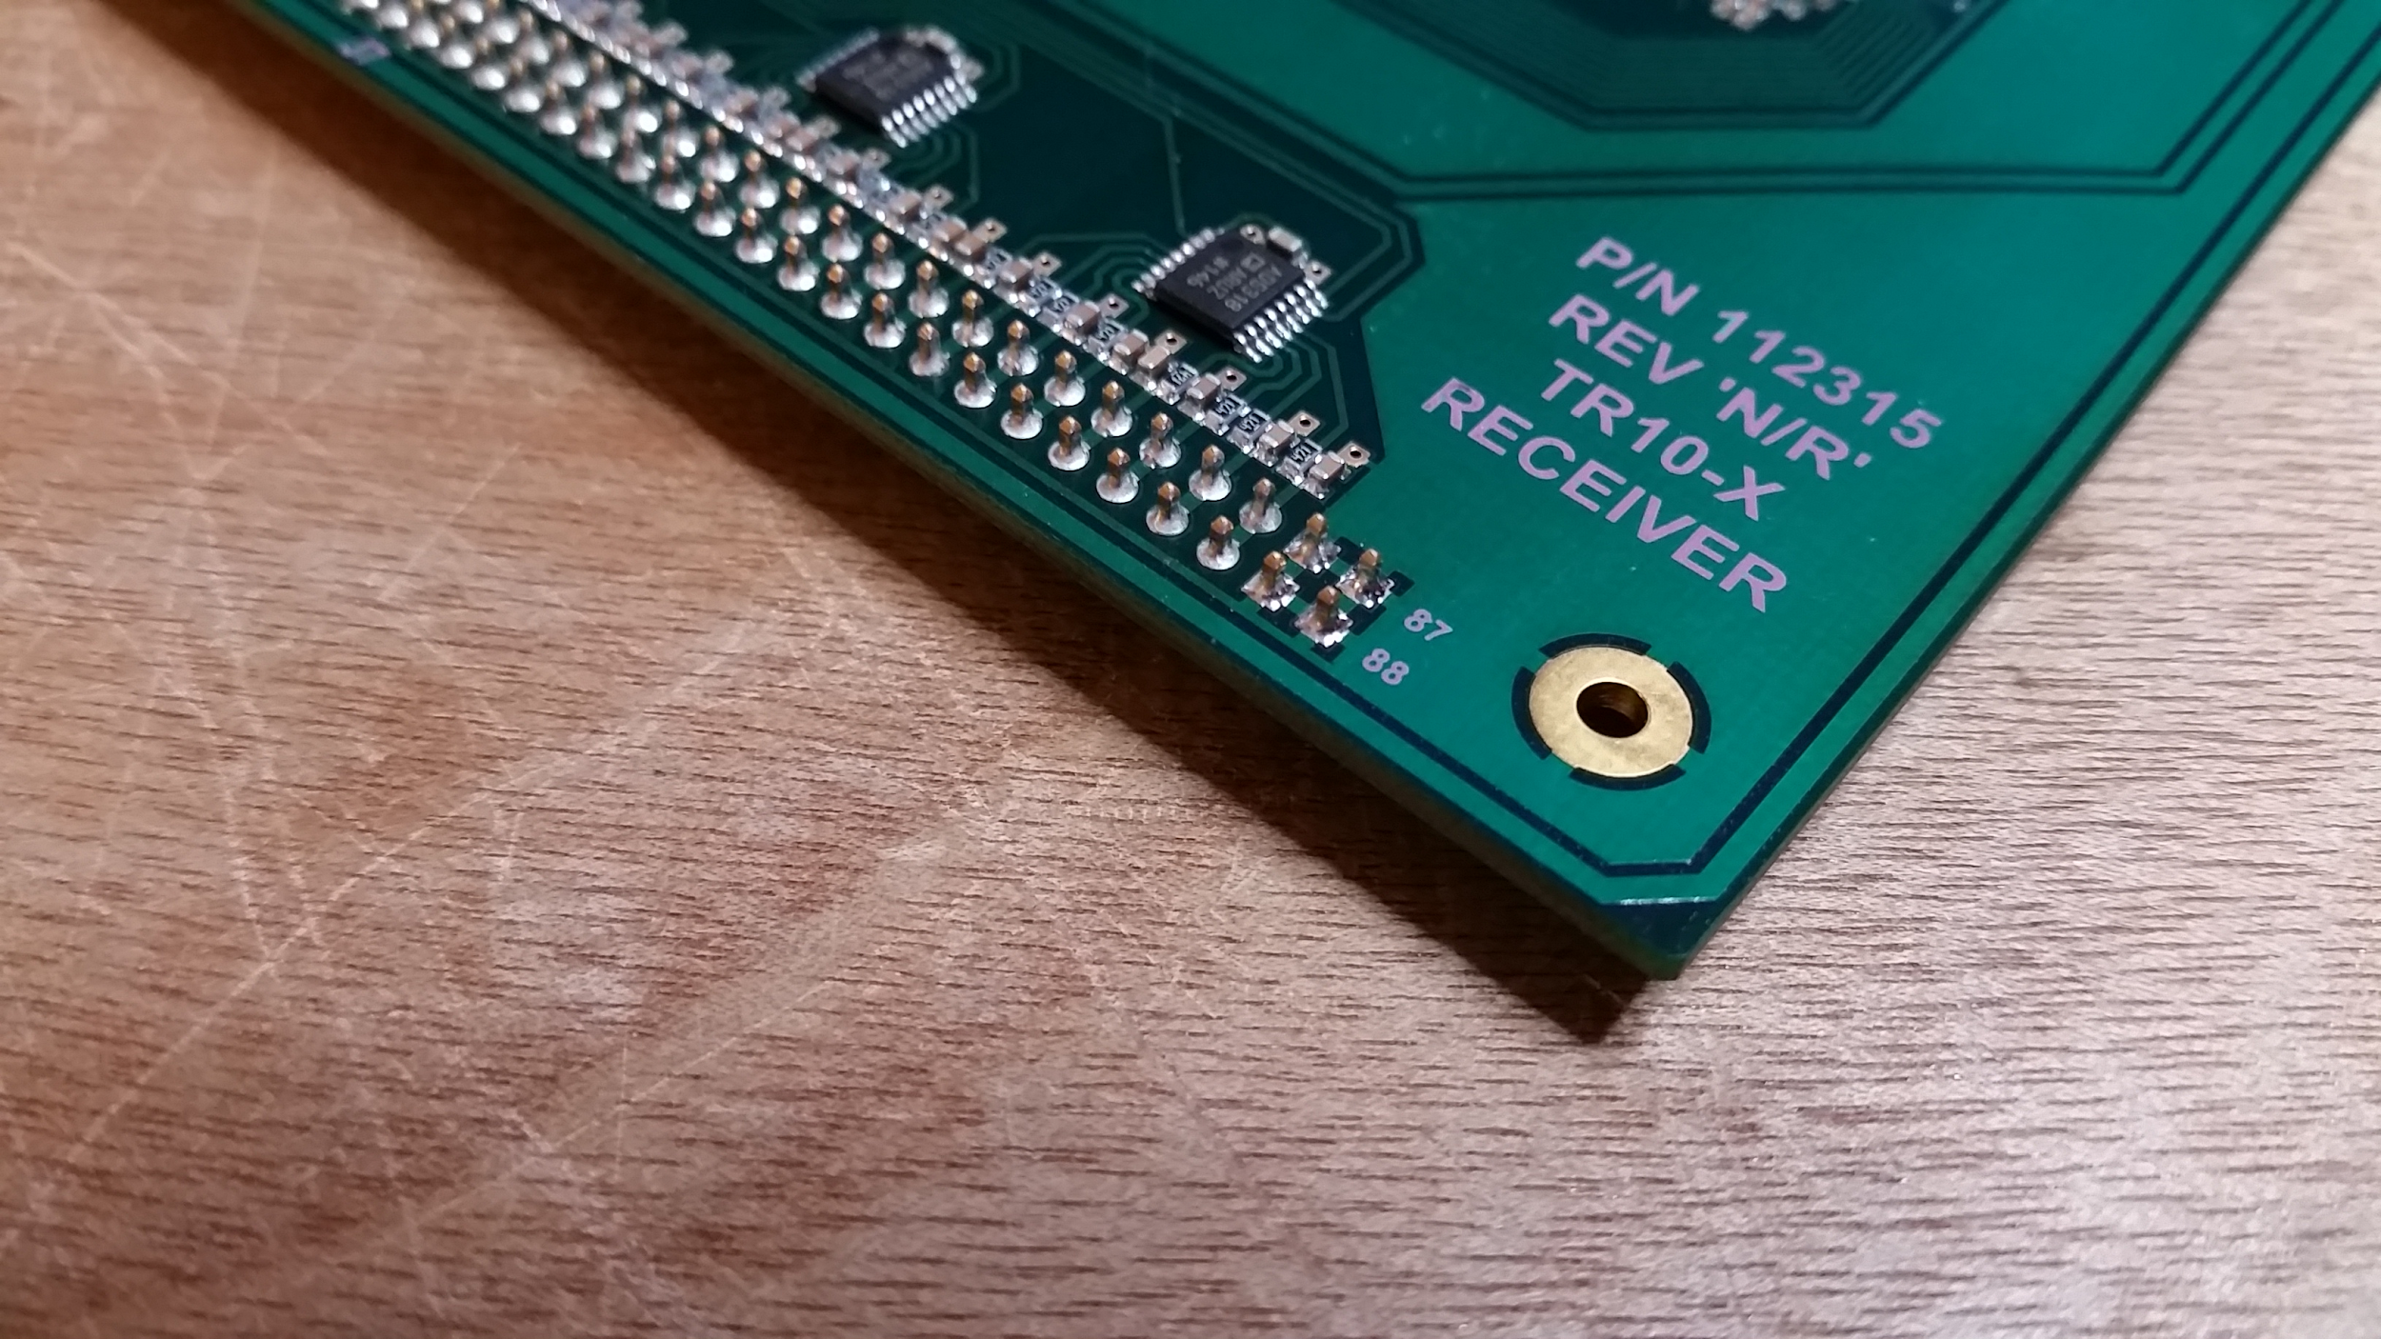
Pinning out an FPGA Board
The supply voltage has to get the the board somehow
Look for pin headers that do not appear to connect to any other devices
The first place I looked was the large header at the bottom of the board
Almost all of the pins connect up the the DACs
The 4 rightmost connect to ground
But the 4 leftmost do not appear to connect to anything but each other
???
Ground

Slide 46
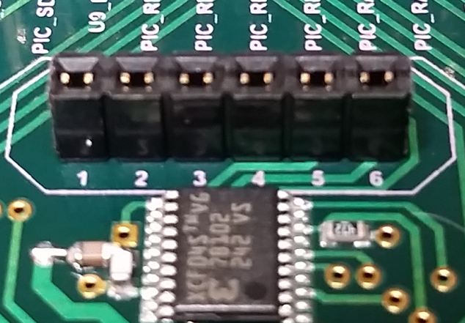
Pinning out an FPGA Board
Just for kicks I tested the continuity between the leftmost pins on the large header with pin #1 on the JTAG header
Turns out it was a perfect connection!
This means that the power coming into the board is a regulated voltage
There was one other quick test to determine the voltage

Slide 47
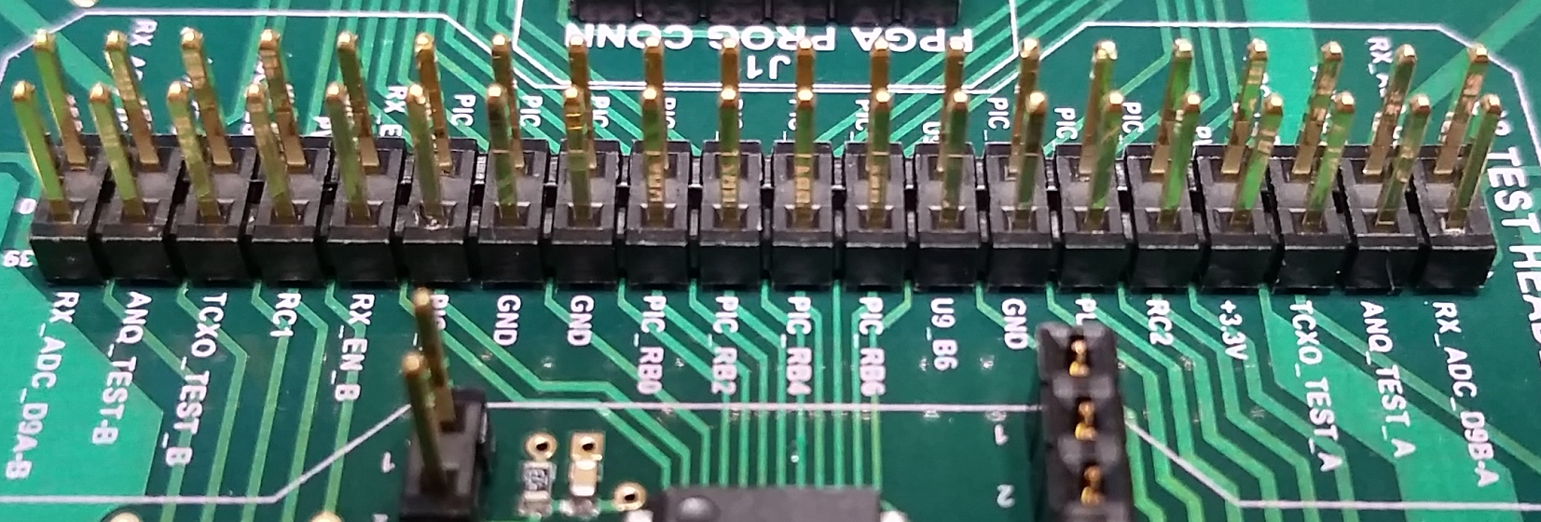
Pinning out an FPGA Board
It turns out that the smaller header in the middle of the board has a pin labeled “+3.3V”
Testing the continuity between it and pin #1 of the JTAG connector showed a perfect connection
Now we know that the voltage coming into the board is a nice 3.3 volts!!!

Slide 48
Pinning out an FPGA Board
The next part is trial and error
There are 4 pins that could be in any order
TMS, TCK, TDO, TDI
You could use one more trick which is to try and find other JTAG supported devices that could be in the chain
If these devices are not BGA then you might be able to poke at the pins to see what connects where
This will only get you TMS, TCK, and either TDO or TDI (or perhaps neither if there are more than two devices and the one you can access is in the middle)

Slide 49
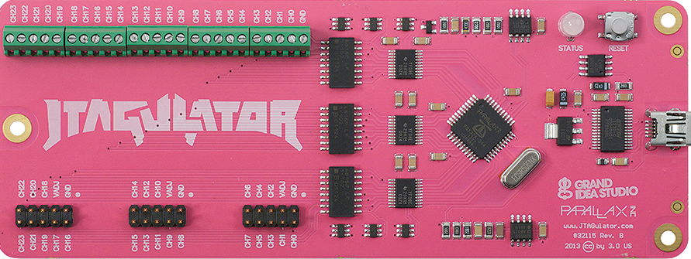
Pinning out an FPGA Board
Thankfully this header uses a pretty standard layout
My Xilinx DLC9G came with a connector that converts the 14 pin connector on the JTAG programmer to a 6 pin header
Turns out that this cable works perfectly!
Don’t worry about getting the connections wrong
The only important ones are VCC (supply) and ground
If you want to avoid having to wire the whole thing up 16 times, then you should order a JTAGulator
This will brute force the pins to get a valid IDCODE from the device
Thus showing the correct pin arrangement for the JTAG header

Slide 50
Pinning out an FPGA Board
Okay so let’s review what we know:
The header labeled “FPGA PROG CONN” is the JTAG header
The leftmost cluster of 4 pins on the large header at the bottom is 3.3 volt supply
The rightmost cluster of 4 pins on the large header at the bottom is ground
Pin #1 of the JTAG header is VCC (reference)
Pin #2 of the JTAG header is ground
Pins 3-6 of the JTAG header are TCK, TDO, TDI, and TMS
This was figured out by luck
The breakout cable for my Xilinx DLC9G matched perfectly!
This is all we need to know to start poking at things!

Slide 51
Pinning out an FPGA Board
A spare server power supply was connected to the board using the ground and 3.3 volt lines at the bottom
The JTAG header was connected to a breadboard using jumpers
The breadboard was so that I could use both my Altera and Xilinx programmers without having to rewire each time
Just to be safe I connected my digital multimeter in series with the 3.3 volt supply to measure current
This was because I had no absolute proof that my supply connections were correct
Watching for something over 1 Amp
That and for things to get toasty on the board...

Slide 52
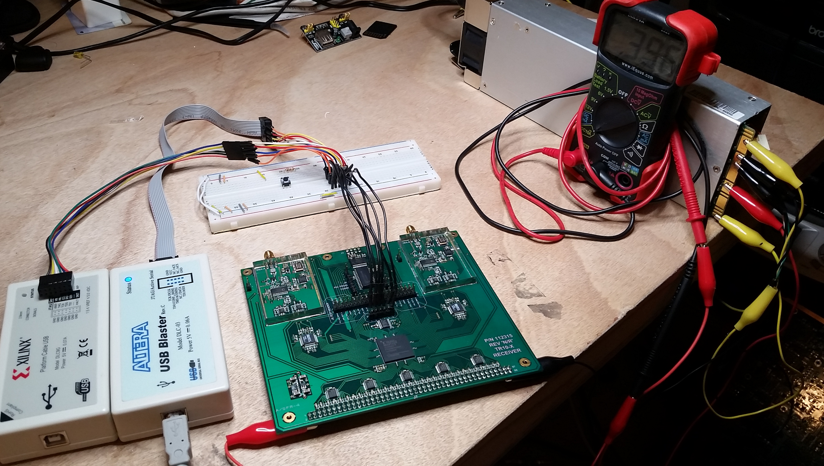

Slide 53
Pinning out an FPGA Board
When the power was first applied the board was drawing ~ 500 mA
After about 20 seconds it settled down to ~ 400 mA
Perfectly acceptable current draw!
Now the question is, are the JTAG pins correct?
The only way to find out is to fire up some software
On to the TopJTAG Probe part of this presentation!

Slide 54
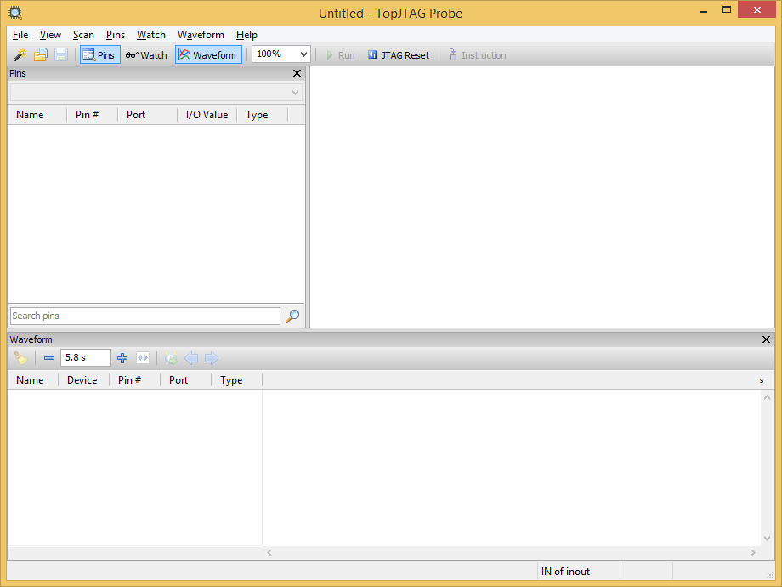
Pinning out an FPGA Board
This is what comes up after starting TopJTAG Probe

Slide 55
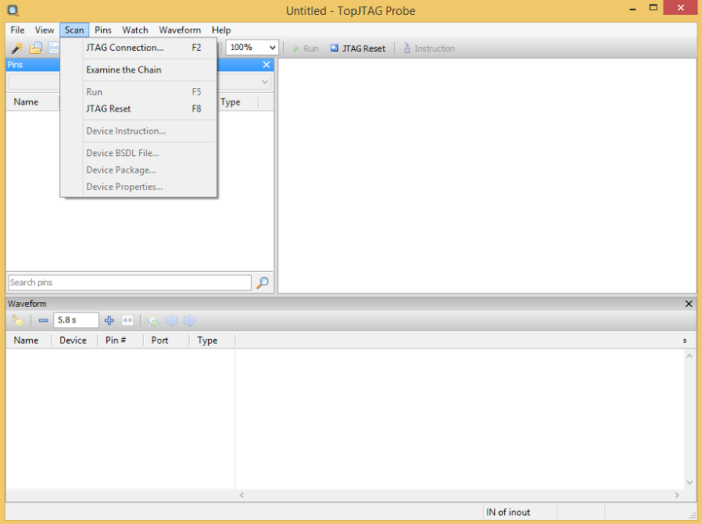
Pinning out an FPGA Board
The first thing to do is select the JTAG connection you want to use
TopJTAG Probe supports several JTAG programmers
I will be using the Altera USB Blaster for this program

Slide 56
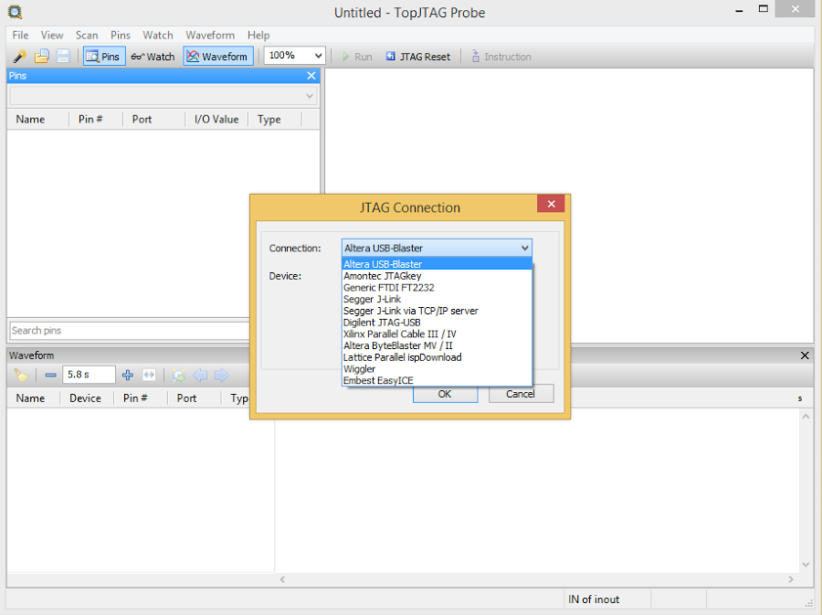
Pinning out an FPGA Board
Here is a view of the programmers supported by TopJTAG Probe

Slide 57
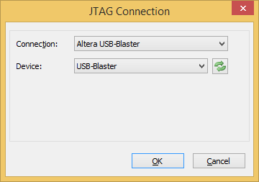
Pinning out an FPGA Board
My programmer was found!

Slide 58
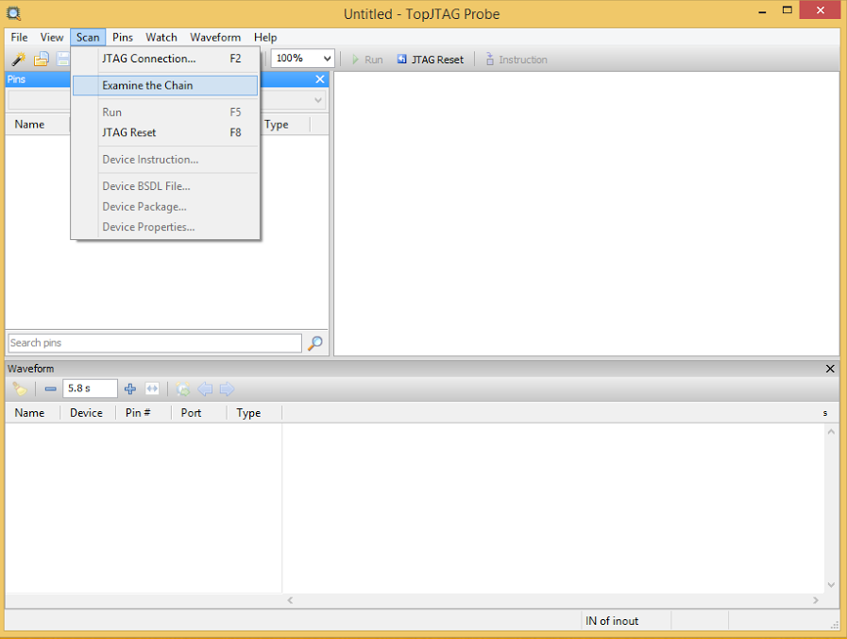
Pinning out an FPGA Board
Now it’s time for the magic moment!!
Examining the chain will attempt to enumerate the JTAG device(s)

Slide 59
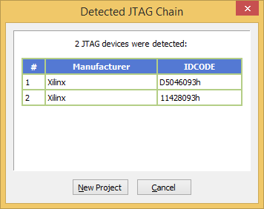
Pinning out an FPGA Board
Woot!!
Two devices were found :D

Slide 60
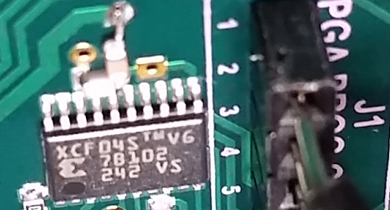
Pinning out an FPGA Board
Almost every board with an FPGA is going to have at least two JTAG devices
This is because *most* FPGAs are volatile
They lose their configuration after being powered off
So, they need flash memory to program themselves on power up
It’s a pretty safe bet that the flash will also be on the JTAG chain
It just so happens that the chip directly above the FPGA is a Xilinx flash
Part number XCF04S

Slide 61
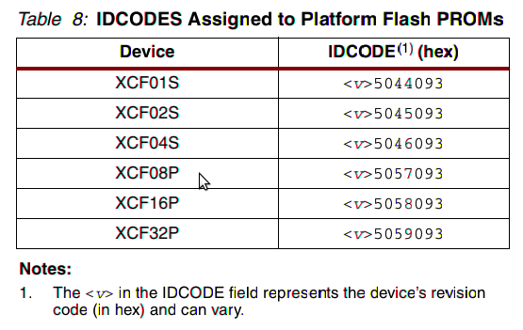
Pinning out an FPGA Board
A quick Google search for “XCF04S IDCODE” returned the Xilinx datasheet for “Platform Flash PROMs”
Link
Page 6 has this nice little table that shows the IDCODE for each type of Platform Flash PROM
TopJTAG Probe is showing the flash as the first device in the chain
D5046093h (‘h’ is for hex) which also happens to be the IDCODE for XCF04S!

Slide 62
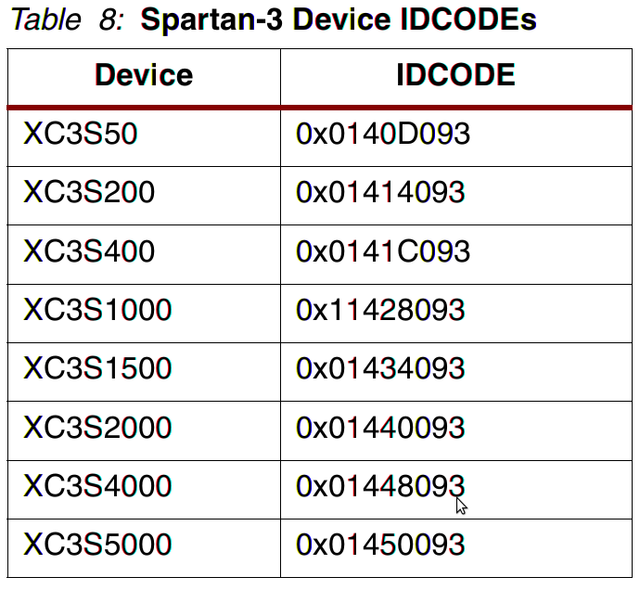
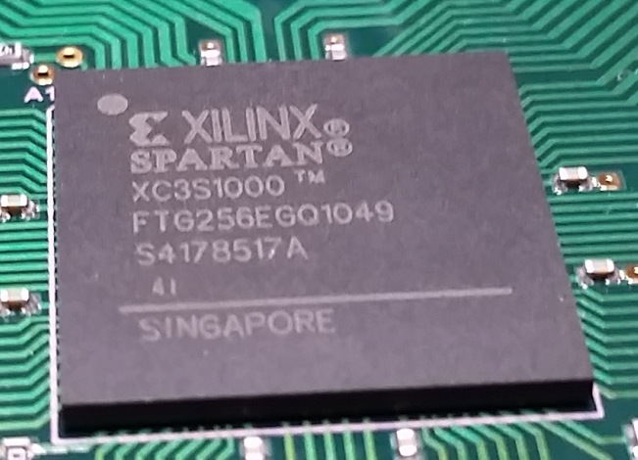
Pinning out an FPGA Board
The other device is likely the FPGA
Googling “11428093 Xilinx” returned a link to the “Spartan-3 FPGA Family Advanced Configuration Architecture” PDF
Link
Doing a search in the PDF for “11428093” turned up the table below
This is perfect because the FPGA is an XC3S1000!!

Slide 63
Pinning out an FPGA Board
Unfortunately there is one more step before getting to see pins on the FPGA
TopJTAG Probe does not understand the internal workings of all JTAG devices
All JTAG devices will have something called a BSDL file
Boundary Scan Description Language
Xilinx is no exception to this
A quick Google search for “spartan 3 bsdl download” turned up a site called bsdl.info
http://bsdl.info/list.htm?f=718

Slide 64
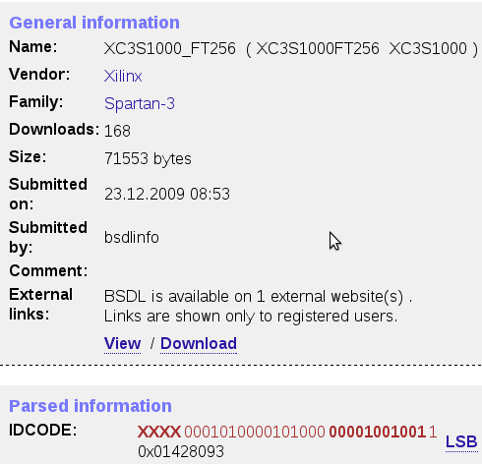
Pinning out an FPGA Board
This board has an XC3S1000 in the FT256 package
Searching for XC3S1000 turned up this page:
Link
The results match the correct IDCODE
There is a link at the bottom to download the BSDL file
Save that off some place nice and safe

Slide 65
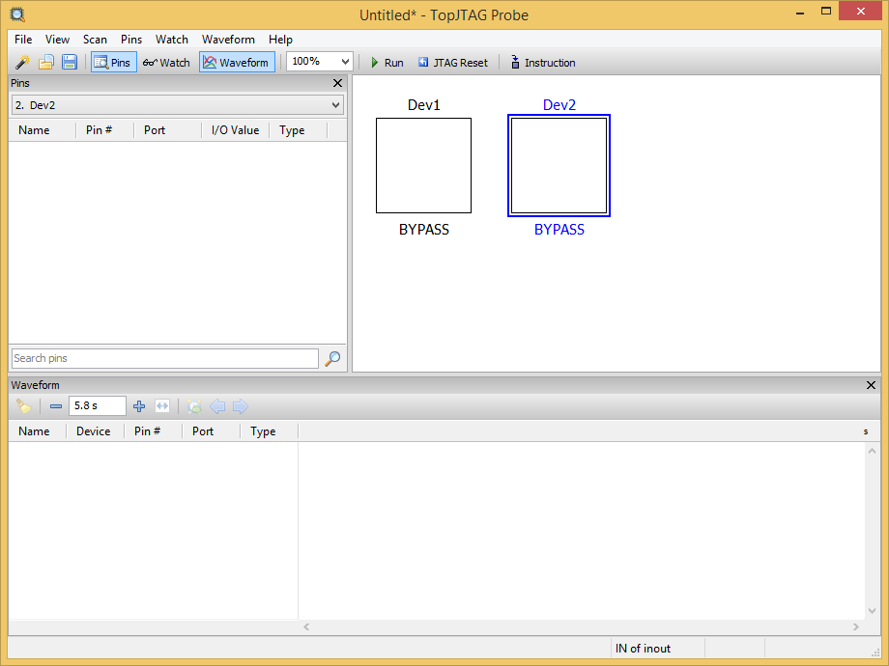
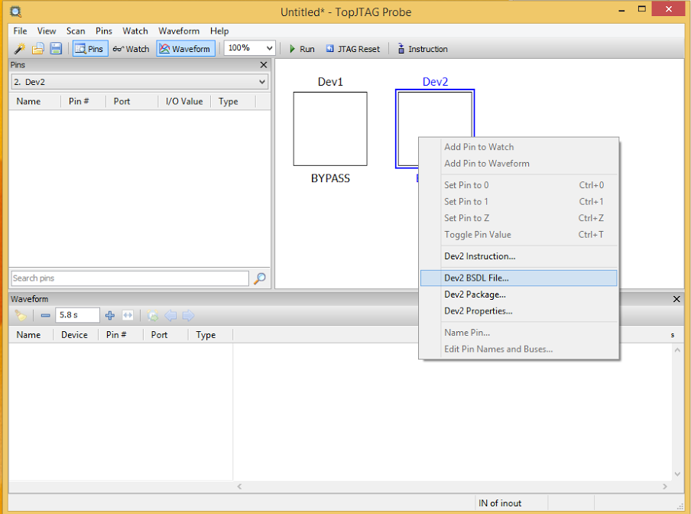
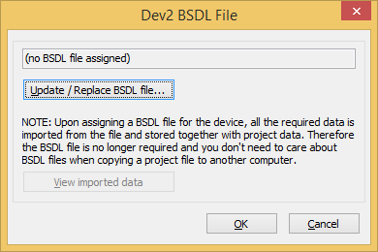
Pinning out an FPGA Board
With the BSDL file for the FPGA in hand it’s time to tell TopJTAG how to talk to the FPGA
Select the second device (Dev2)
Right click and select “Dev2 BSDL File”
Click “Update/Replace BSDL file…”

Slide 66
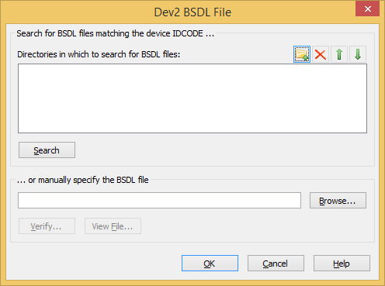
Pinning out an FPGA Board
Click on the “Browse” button
Then select the BSDL file you just downloaded

Slide 67
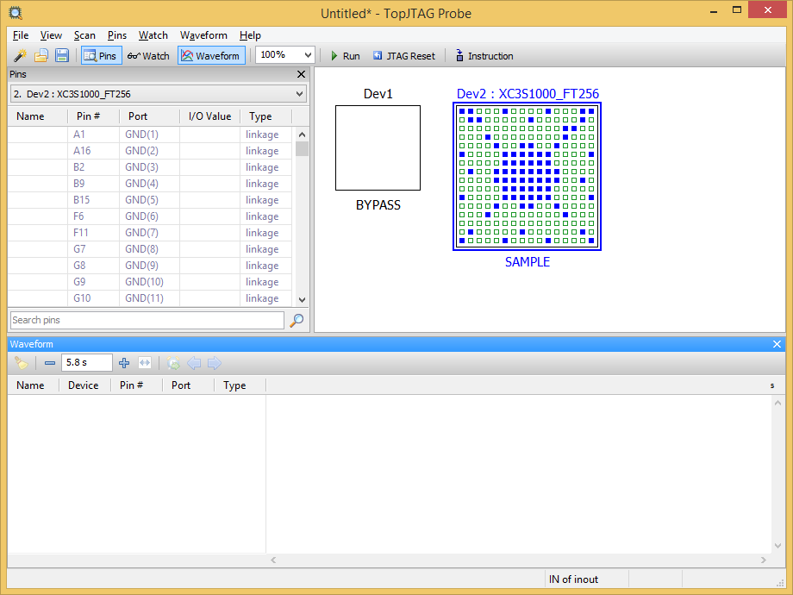
Pinning out an FPGA Board
Click “OK” to close the “Dev2 BSDL File” window
Finally, click “OK” to close the other “Dev2 BSDL File” window
You should now see a window like this

Slide 68
Pinning out an FPGA Board
We are not going to worry about the flash PROM
Just leave it in BYPASS mode so it does not affect the output from the FPGA
You should notice that the FPGA is in SAMPLE mode
This is what we want as it will allow us to sample the IO pins

Slide 69
Pinning out an FPGA Board
To start the sampling, click on “Run”

Slide 70
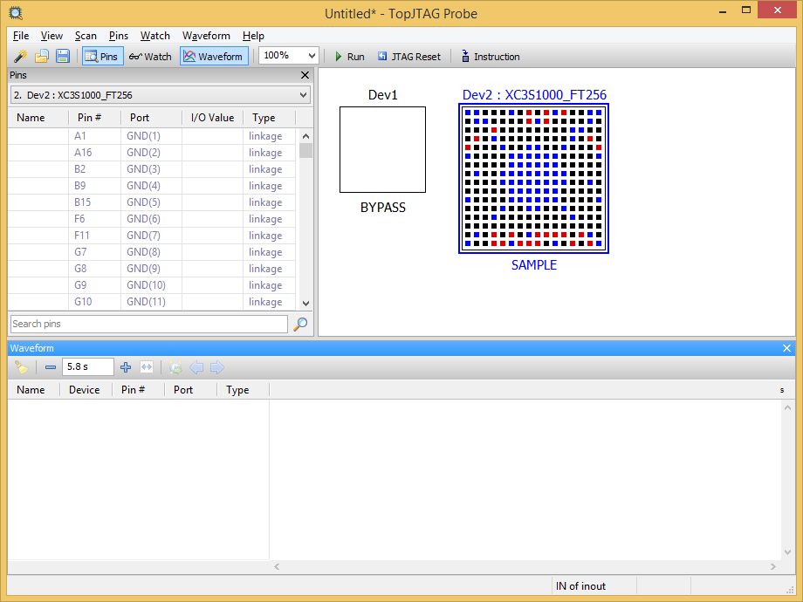
Pinning out an FPGA Board
Your screen will now look like this:

Slide 71
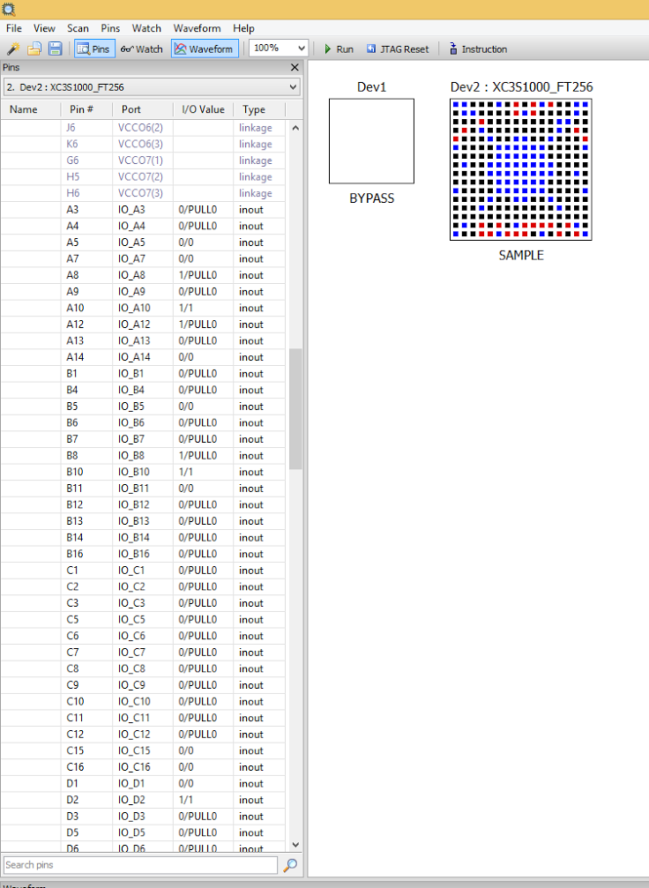
Pinning out an FPGA Board
The colors on the selected chip will change based on current pin values
But, that’s not all too useful
To see exactly what’s happening, expand the window to fullscreen and scroll about halfway down on the left panel
This will show all of the pins and their current values

Slide 72
Pinning out an FPGA Board
While the sampling is running, look for pins that change a lot
There should be several that are changing
This is a problem
All the pins changing is “noise”
In order to figure out what goes where, we need to make the FPGA stop and just listen

Slide 73
Pinning out an FPGA Board
On this board the FPGA only has connections to the two ADCs, 5 DACs and two PLL chips (these are in the analog sections of the board)
There is also at least one clock input to the FPGA
All FPGAs need a clock input of some sort
The FPGA will not drive this clock, it will usually be free running all the time
Right now the FPGA is sending control signals to the ADCs, DACs, and PLLs
This means that we cannot tell what is coming from where
The only way to accomplish this (that I know of) is to erase the flash

Slide 74
Pinning out an FPGA Board
Before erasing the flash, be sure to copy off the contents!
That way you can just upload it later if you want it back to stock
There are several tools to do this
Since this is a Xilinx part (both the FPGA and flash) I used the Xilinx tool Impact to download and erase the flash
Then you just need to power cycle board
Now there will be no configuration for the FPGA
Most of the time this means that the FPGA will have all its IO pins in HIGH-Z
High impedance state

Slide 75
Pinning out an FPGA Board
If you start the sampling again you should notice that most of the pins are no longer toggling
This is luck
It just so happens that the FPGA controls all of the other peripherals
On some boards there will be other devices that send data to the FPGA without being asked to do so
For those boards you’ll have to get a little more creative to figure out all of the pins

Slide 76
Pinning out an FPGA Board
Now that the FPGA is idle, we can start poking at some of the pins
On this board it’s clear that the ADCs have 18 traces connecting to each of the ADCs
I’m picking the ADCs since they are the closest to the FPGA and I can see the traces going directly to the FPGA

Slide 77
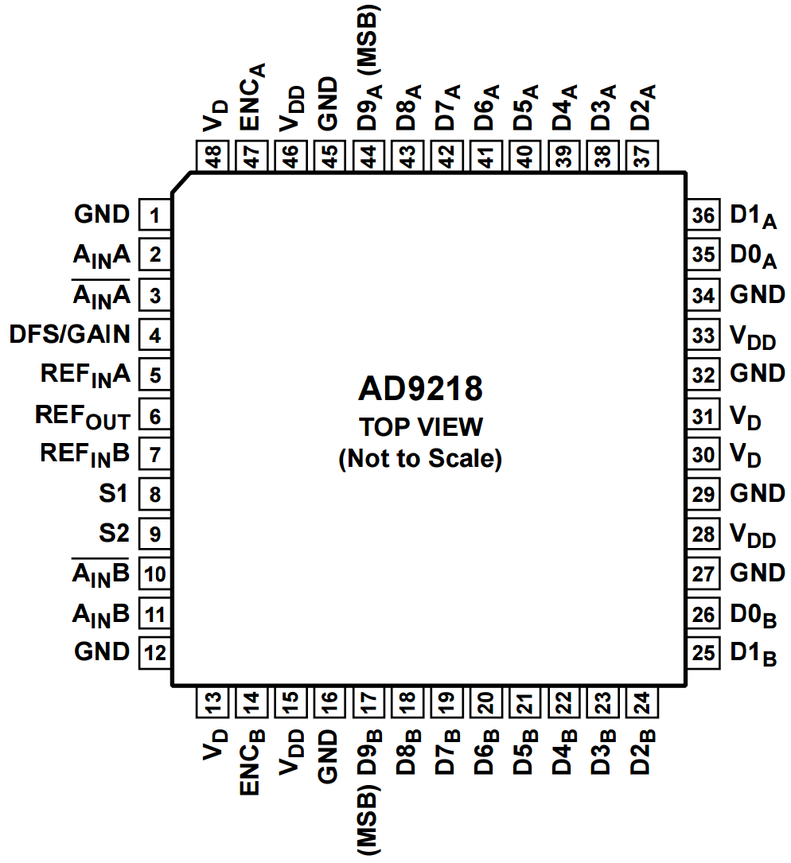
Pinning out an FPGA Board
Looking up the part number for the ADC (AD9218) shows this pinout
Orienting the board with the flat spot on the AD9218, you should be able to see that the FPGA has connections to D2-10 on the A channel and B channel
The bottom two bits are ignored
You can tell by the fact that they have no traces and to be extra sure you can probe them later on

Slide 78
Pinning out an FPGA Board
The goal is going to be to apply voltage to one of the pins and see if there is a change in TopJTAG Probe
Before we can do this, we need to set up some kind of probe that can apply voltage at a specific time
I did this with a breadboard, jumper wires, push button, and an oscilloscope probe

Slide 79
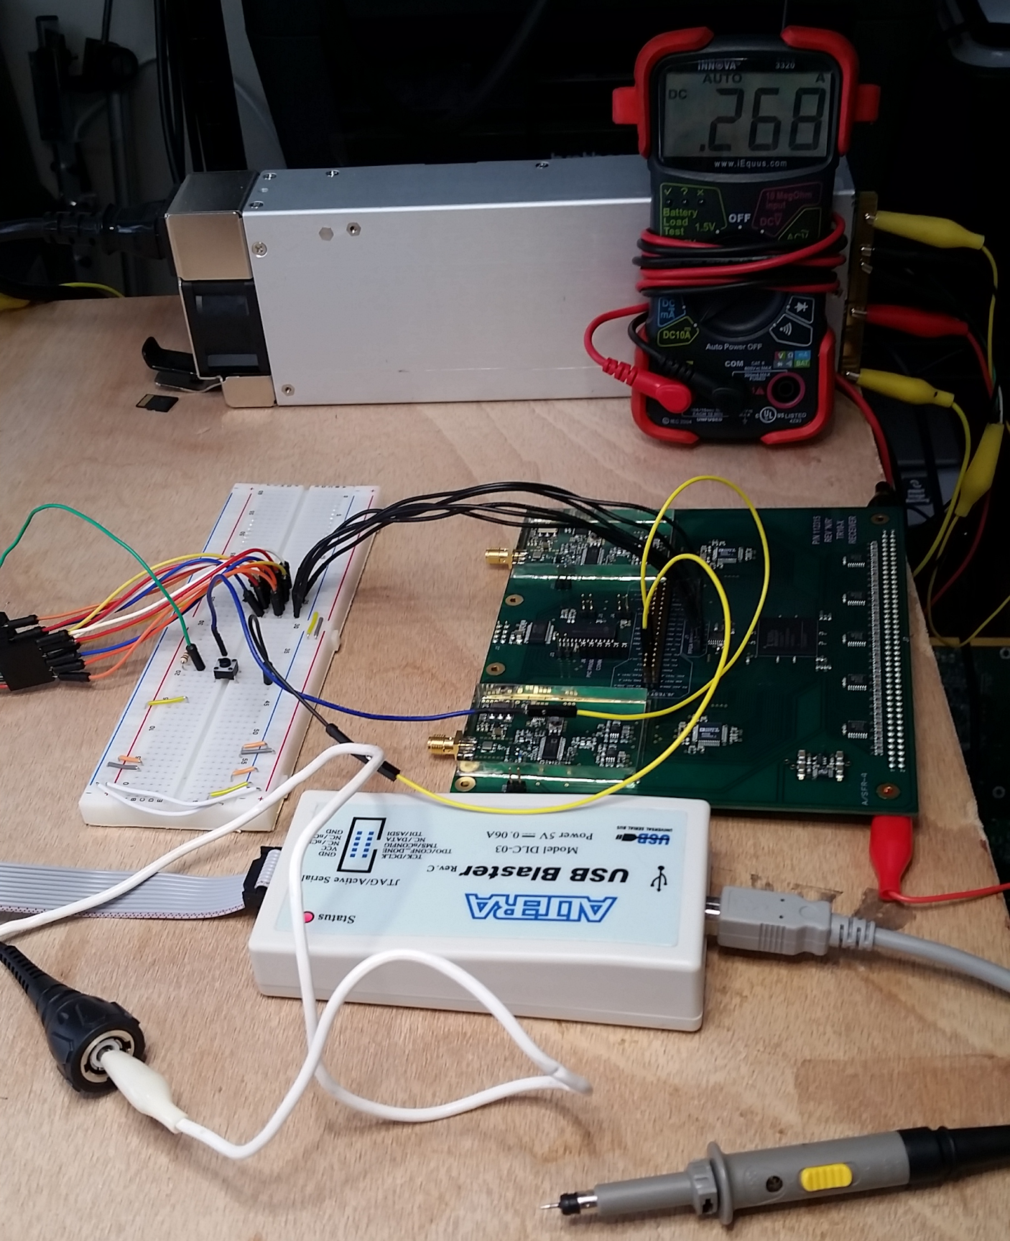
Pinning out an FPGA Board
Here is the setup
The green (or is it yellow?) wires connect up to the header that’s just above the FPGA
One wire connects to 3.3 volts
The other one connects to ground
The white alligator clip connects to the center pin on my oscilloscope probe and then connects to the push button (more on that later)
Also notice that the probe has had its cover removed
This gives me a nice sharp point to probe small pins with

Slide 80
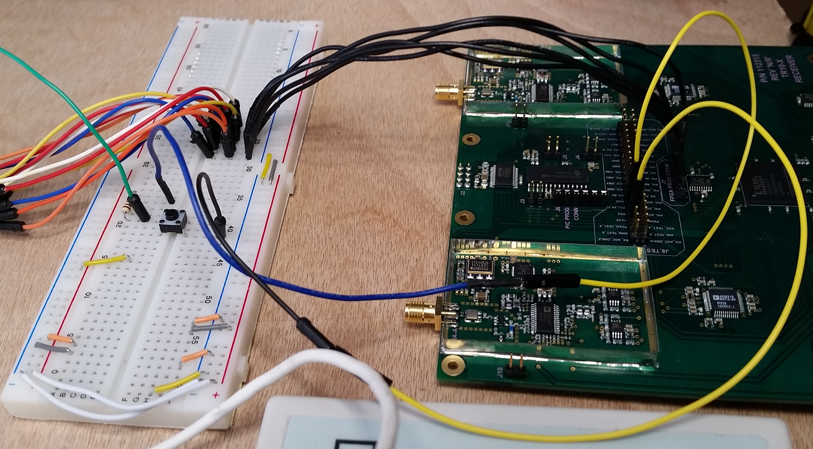
To o’scope center pin
JTAG connections
Ground
3.3 V

Slide 81
Pinning out an FPGA Board
The pushbutton is configured so that when it is not pressed then the probe is grounded through a resistor
When the pushbutton is pressed, the probe gets 3.3 volts
Originally the probe was always connected to 3.3 volts
This made it very difficult to be sure that the pin I was looking at in TopJTAG Probe was the correct one
With the switch in place all that you need to do is press the button, look for a change, then release the button and make sure the same pin changes to zero

Slide 82
Pinning out an FPGA Board
One note about the probe
It is in 1X mode so that there is resistance, but it isn’t all that high
You do not want to be probing the board with direct current (no resistance)
This is a sure fire way to fry a chip
Think about the possibility that one of the devices has a pin that is connected directly to ground by default
Applying direct 3.3 volts could fry that input :(

Slide 83
Pinning out an FPGA Board
Okay, so it’s time to probe some pins!
First make sure that TopJTAG Probe is currently sampling
Connect the o’scope probe to pin D2_{A} (chosen because it’s on the edge and easy to get to)
Press the pushbutton and look for a change in the pin list in TopJTAG
There are too many pins to see in one screen, so you might have to scroll down and push the button again
Keep doing this until you’ve either exhausted all the pins or found a pin that changes when you push the button

Slide 84
Pinning out an FPGA Board
In this case pin L15 changes to 1 when the button is pressed and goes back to 0 when released!
Write this down and move on to the next pin
Do this for all of the DX_{A} pins
There is also an encode pin (think of it as the clock)
This is something you would either look at the datasheet to understand or just know how most parallel ADCs work
The pin is listed as ENC_{A}
Find that pin and figure out which FPGA pin it hooks to

Slide 85
Pinning out an FPGA Board
That’s all it takes to determine how the ADC channel A connects up!
The same process is used to get channel B and the entire process is repeated for the other ADC
You can also repeat the process on the DACs

Slide 86
Pinning out an FPGA Board
There is still one very important thing to determine
The FPGA clocks
Right now we know how the ADCs hook up, but we cannot do anything in an FPGA without a clock
FPGAs are synchronous devices, so a clock is a must
Somewhere on this board is a clock that is fed into the FPGA
There might be multiple clocks too

Slide 87
Pinning out an FPGA Board
One of the nice things about the clocks is that even if the FPGA isn’t configured, you can still see the pins toggling!
Start sampling with TopJTAG Probe
Look for pins that are toggling on their own
In this case the pins that toggle on their own are:
R9 => Global clock input
T9 => Global clock input
B8 => Global clock input
A8 => Global clock input
T9 => Global clock input
The pin definitions were found by Googling “Spartan 3 package”
Which returned a result for the Xilinx packaging spec for Spartan 3
Look on page 196 to see the pinout diagram
GCLK stands for Global Clock

Slide 88
Pinning out an FPGA Board
Now you know what pins might be clocks
For an FPGA you almost always have clock inputs to the GCLK pins
It’s rare to have a clock input to a normal IO pin
The next step is to write a simple VHDL/Verilog design that simply copies the input clock (one of the pins in the last slide) to some known output pin
I used one of the DAC pins for this
Two reasons why:
Easy to access the pins
There are 3 pins which are supposed to be driven by the FPGA
This means that I will not be accidentally driving on both sides!
Upload the design and use a scope to see if you get an output on the pin you chose

Slide 89
Pinning out an FPGA Board
Not only does this show you what pin(s) have clock(s), but it also shows you the clock speed!
Which is super important for FPGA designs as you need to know how fast the incoming clock is running

Slide 90
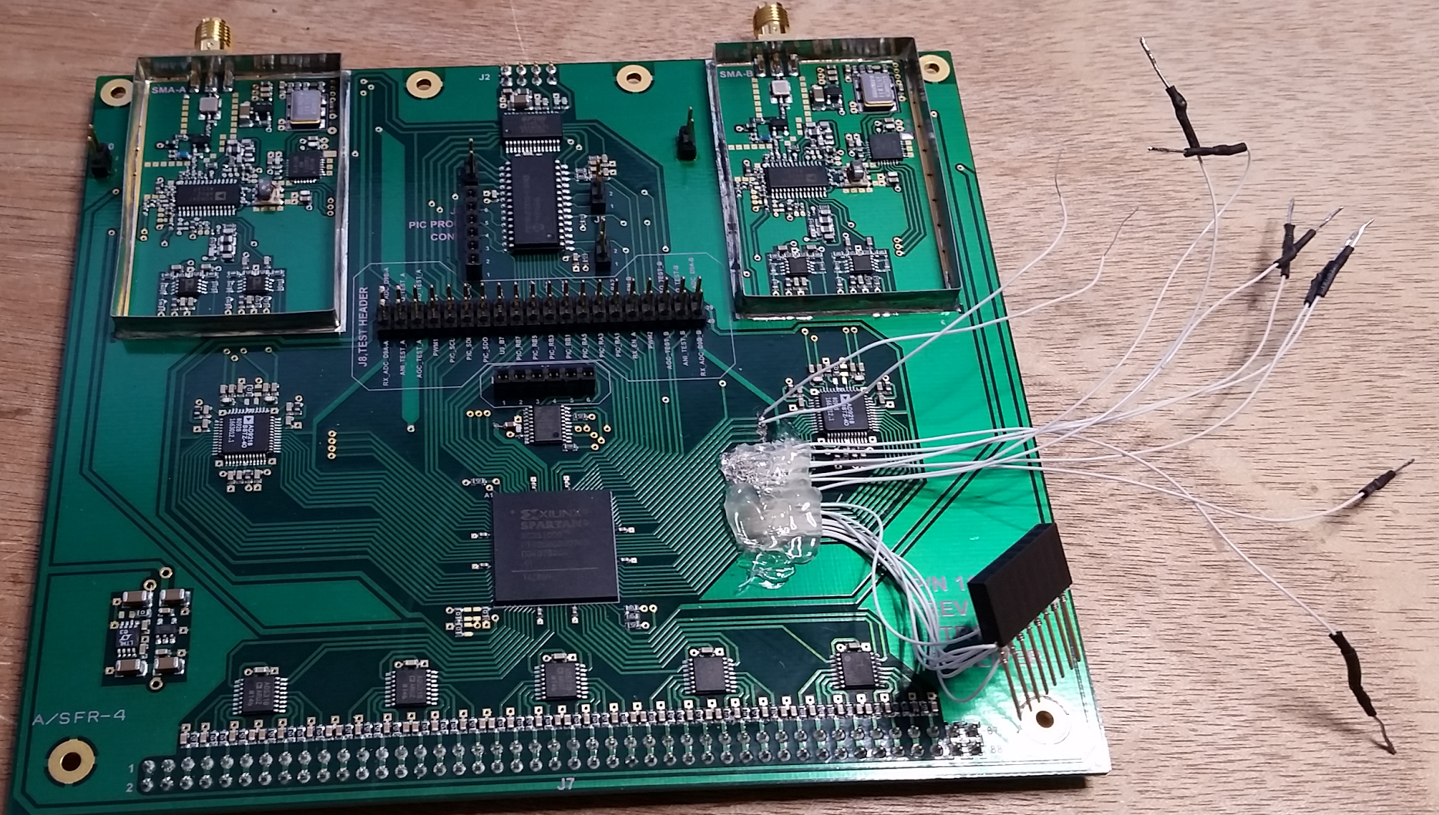
Pinning out an FPGA Board
The end goal for this board is to hijack the samples coming from the ADCs
Here is the prototype board with wires soldered to the ADC to FPGA traces
The traces were cut and wires soldered to the ADC side of the traces
Might not work, but what the heck right?

Slide 91
Fin
Thanks for viewing!
Questions/Comments/Concerns?
This presentation was created for the July 2015 Unallocated Space Minicon
Check out http://www.unallocatedspace.org for information about this wonderful Hackerspace!

